Slide 2
Përmbajtja
Hyrje ne Sistemet Operative
Struktura e Sistemeve Operative
Menaxhimi i Proceseve
Threads & Concurrency
Skedulimi i CPU, Sinkronizimi, Deadlocks
Menaxhimi i Memories, Memoria Kryesore dhe Virtuale
Struktura e Sistemeve për Ruajtjen e Shënimeve
Ndërfaqja dhe Implementimi i File Sistemeve
Virtualizimi, Cloud Computing

Slide 3
File Sistemet
Konceptet e File
Metodat e qasjes
Struktura e disqeve dhe direktoriumeve
Ngarkimi i File Sistemeve
Shpërndarja e File
Mbrojtja

Slide 4

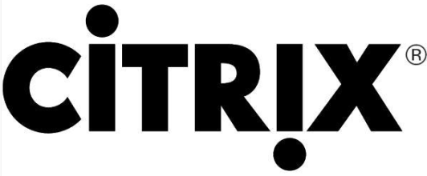

virtualization
What is Virtualization?
Virtualization is the process of creating a software-based or virtual, version of something.
Old but still relevant
Desktop Virtualization
Server Virtualization
Network Virtualization
Storage Virtualization
Application Virtualization

Slide 5
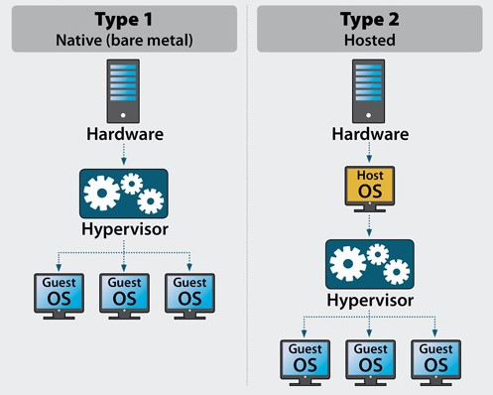
virtualization
Virtualization Types
Type 1 / Bare Metal
Type 2 / Hosted

Slide 6
virtualization

Slide 7
virtualization
Type 1 / Bare Metal
Applications
Applications
Applications
V i r t u a l
Guest OS (Windows)
Guest OS (Linux)
Guest OS (VMware ESX)
Virtual Machine
Virtual Machine
Virtual Machine
Virtualization Layer (Hypervisor)
P h y s i c a l
Hardware

Slide 8
virtualization
Type 2 / Hosted
V i r t u a l
Applications
Applications
Applications
Guest OS (Windows)
Guest OS (Linux)
Guest OS (VMware ESX)
Virtual Machine
Virtual Machine
Virtual Machine
P h y s i c a l
Virtual Machine Manager(Server Products)
Host OS(Server Products)
Hardware

Slide 9
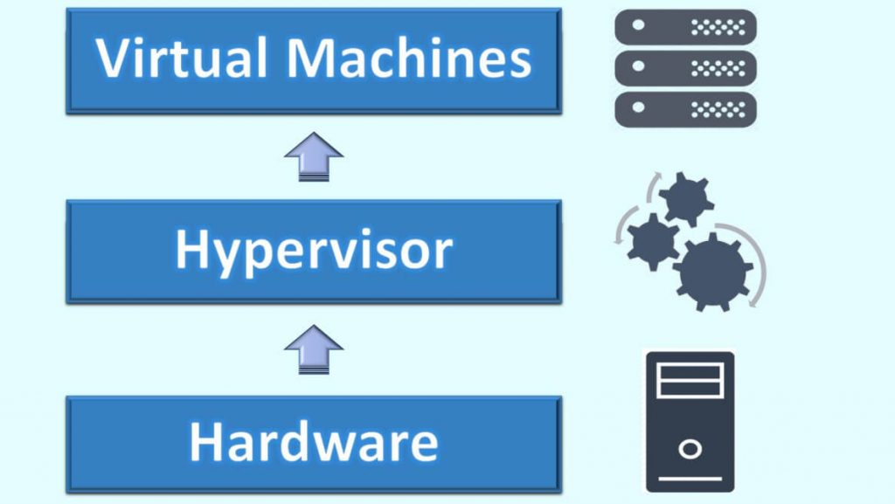
virtualization
What is a hypervisor?
A hypervisor, also called a virtual machine manager (VMM), is a program that allows multiple operating systems to share a single hardware host. Each operating system appears to have the host's processor, memory, and other resources all to itself. However, the hypervisor is actually controlling the host processor and resources, allocating what is needed to each operating system in turn and making sure that the guest operating systems (called virtual machines) cannot disrupt each other.

Slide 10
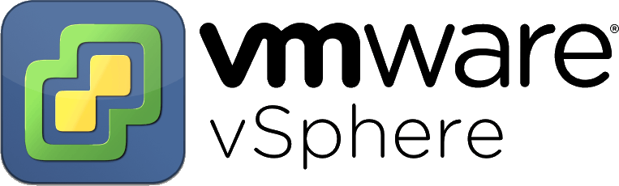
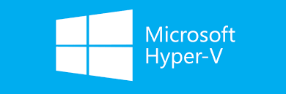
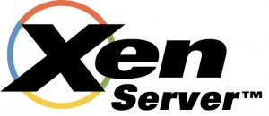
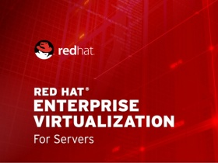
virtualization
Type 1 Hypervisors:
VMware vSphere / ESXi
Microsoft Hyper V
Xen / Citrix XenServer
Red Hat Enterprise Virtualization (RHEV)

Slide 11
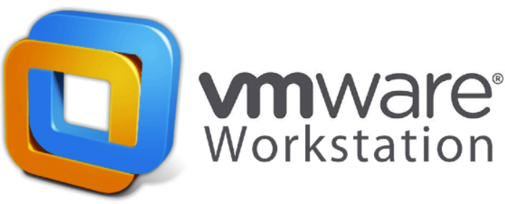
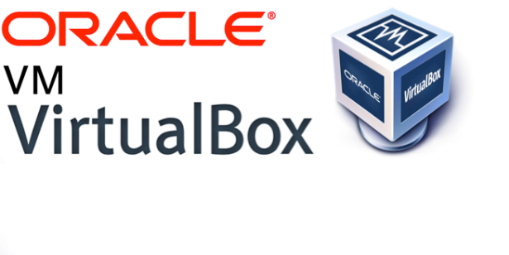
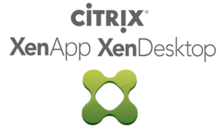
virtualization
Type 2 Hypervisors:
VMware Workstation
Microsoft Hyper V
Oracle VM VirtualBox
Citrix XenServer

Slide 12
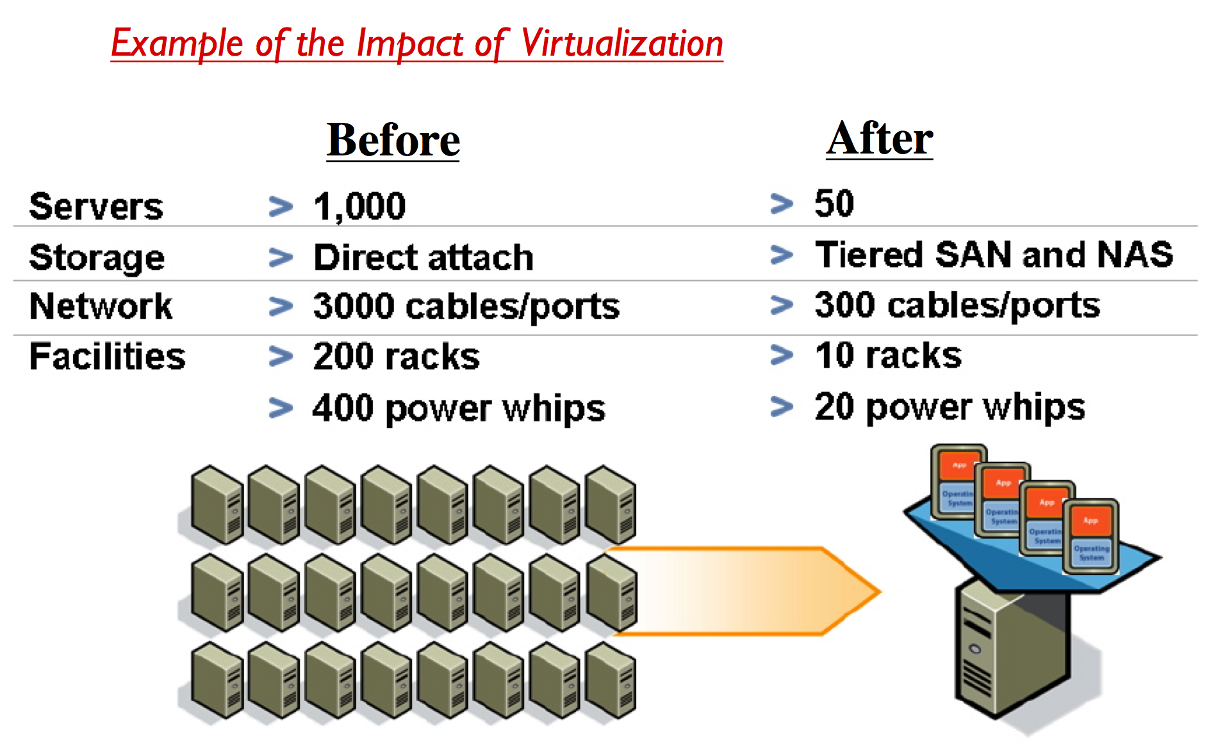
virtualization
Benefits from Virtualization:
Cost Savings
Flexibility
Centralization
Speed
Downtime
Disaster Recovery

Slide 13
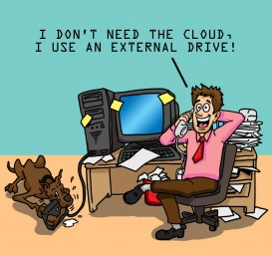
Are we using the cloud yet?

Slide 14


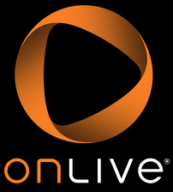


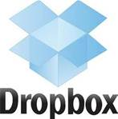
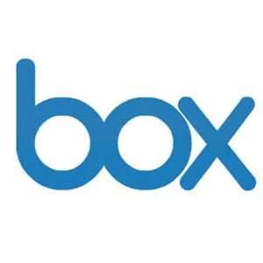

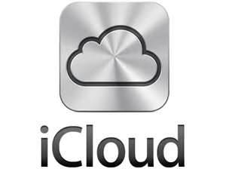

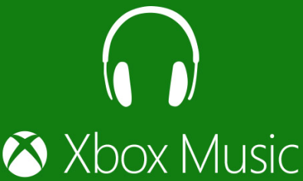



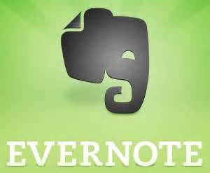



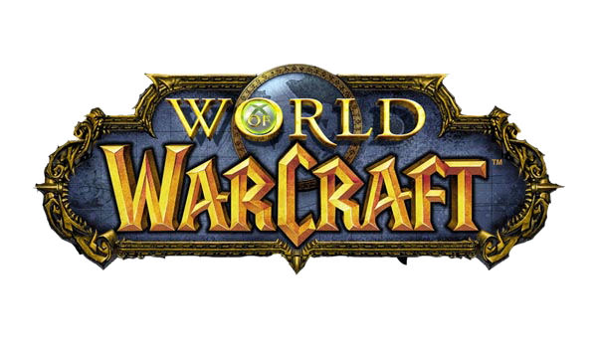


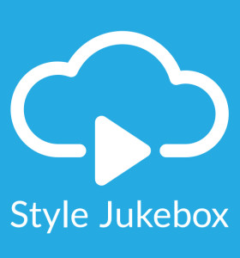

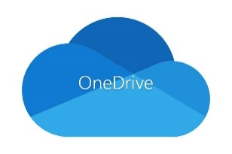


Are we using the cloud yet?

Slide 15
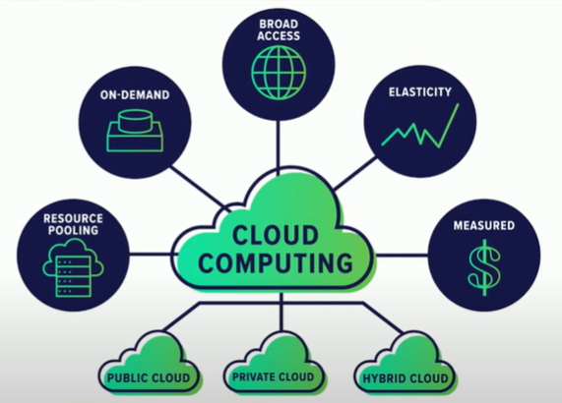
What is Cloud Computing
NIST Definition of Cloud Computing:
"Cloud computing is a model for enabling convenient, on-demand network access to a shared pool of configurable computing resources (e.g., networks, servers, storage, applications, and services) that can be rapidly provisioned and released with minimal management effort or service provider interaction."
Cloud computing is a new way of thinking when delivering IT enabled business services like application development and test.
Cloud is:
A new consumption and delivery model inspired by consumer Internet services
End-user focused
Cloud Enables:
Self-service
Sourcing options
Economies of scale

Slide 16
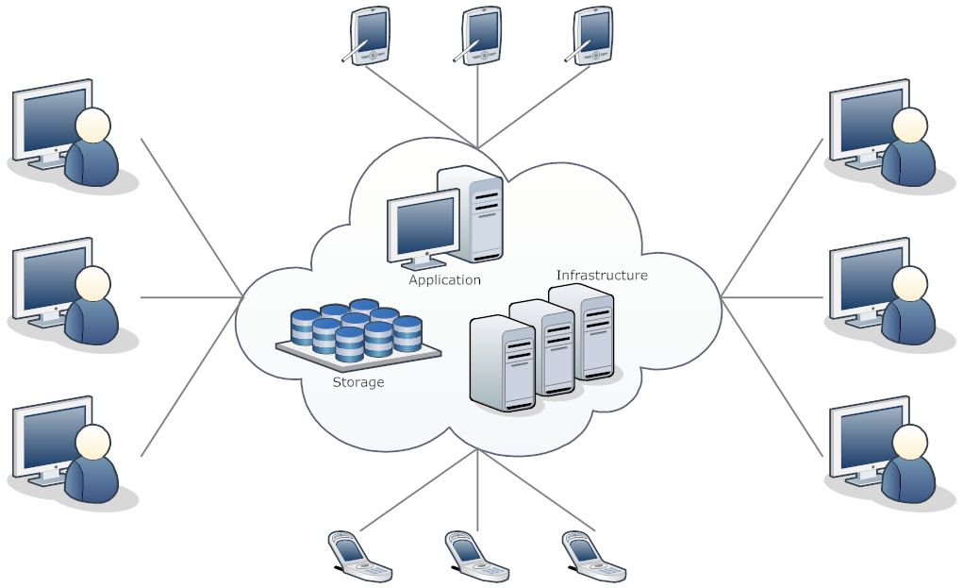
Cloud Computing Network
The network is critical to Cloud Computing
Every Cloud is some combination of a service and deployment model
Regardless of the type of cloud, one fact remains true:
No Network means NO Cloud
Without Network:
Users cannot access their cloud services.
Applications, data, and users cannot move between clouds.
The infrastructure components that must work together to create a cloud cannot.

Slide 17
Attributes of Cloud Networking
Scalability: The cloud network must scale to the overall level of throughput required to ensure that it does not become a bottleneck.
Low Latency: The cloud network must deliver microsecond latency across the entire network fabric because low latency improves application performance and server utilization.
Guaranteed Performance: The cloud network must provide predictable performance to service many simultaneous applications in the network, including video, voice, and web traffic.
Extensible Management: Real-time upgrades and image/patch management in a large cloud-network is a daunting challenge to network administrators.
Self-Healing Resilience: Cloud networks operate 24x7, so downtime is not an option. This requires a network architecture that offers self-healing and the ability for transparent in-service software updates.

Slide 18
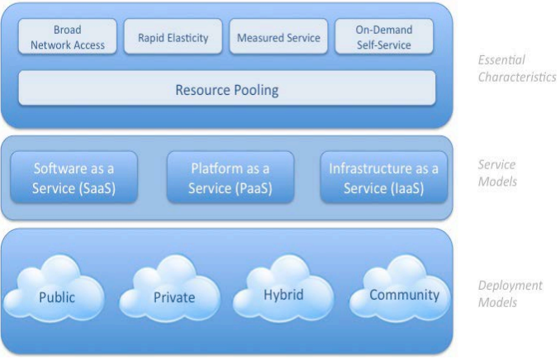
Visual Model of Cloud Computing Definition

Slide 19
Cloud Computing: Essential Characteristics
On-demand self service
Users automatically access computing resources (e.g. servers, storage etc.) as needed.
Broad network access
Services available over the network can be accessed using mobile/smart phones, tablets, laptops and desktops.
Resource pooling
Computing resources (including memory and bandwidth) can be pooled to serve multiple customers at the same time.
Location independence
Rapid elasticity
Ability to quickly scale in/out service with demand, at any time.
Measured service
Control, optimize services based on metering (i.e. pay-per-use pricing model)
Type of service include storage, processing, bandwidth etc.

Slide 20
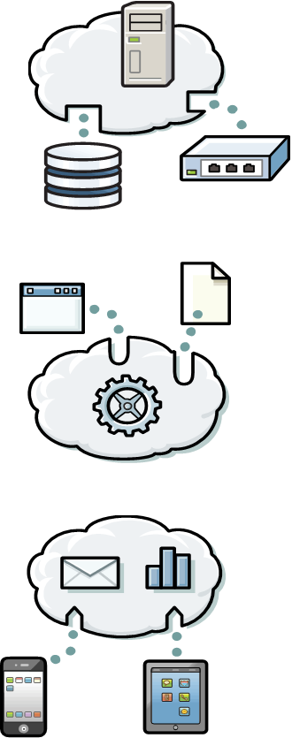
Cloud Service Models
IaaS - Infrastructure as a service
Provision servers
Storage
Networking resources
PaaS - Platform as a service
Middleware platform
Solution stack
Both accessible over a network
SaaS - Software as a service
Software
Applications
Or services that are delivered over a network

Slide 21
Infrastructure as a service (IaaS) architecture
An infrastructure provider (IP) makes an entire computing infrastructure available “as a service”
Manages a large pool of computing resources and uses virtualization to assign and dynamically resize customer resources
Customers rent processing capacity, memory, data storage, and networking resources that are provisioned over a network

Slide 22
Platform as a service (PaaS) architecture
Service provider (SP) supplies the software platform or middleware where the applications run
Service user is responsible for the creation, updating, and maintenance of the application
The sizing of the hardware that is required for the execution of the software is made in an understandable manner

Slide 23
Software as a service (SaaS) architecture
Service provider (SP) is responsible for the creation, updating, and maintenance of software and application
Service user accesses the service through Internet-based interfaces

Slide 24
Split of Responsibilities: provider-side and consumer-side
Traditional
on-premises
Infrastructure as a service
Platform as a service
Software as a service
Applications
Applications
Applications
Applications
Data
Data
Data
Data
Runtime
Runtime
Runtime
Runtime
Middleware
Middleware
Middleware
Middleware
O/S
O/S
O/S
O/S
Virtualization
Virtualization
Virtualization
Virtualization
Servers
Servers
Servers
Servers
Storage
Storage
Storage
Storage
Networking
Networking
Networking
Networking
Client manages
Vendor manages in the cloud

Slide 25
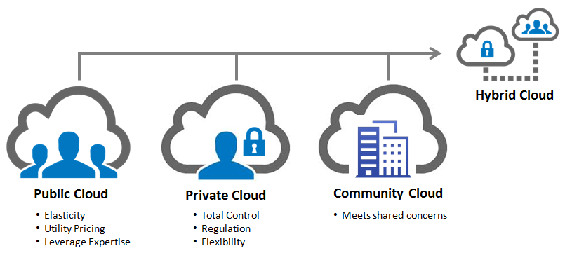
Cloud Deployment Models
Multiple clouds coexist:
Private
Public
Community
Hybrid

Slide 26
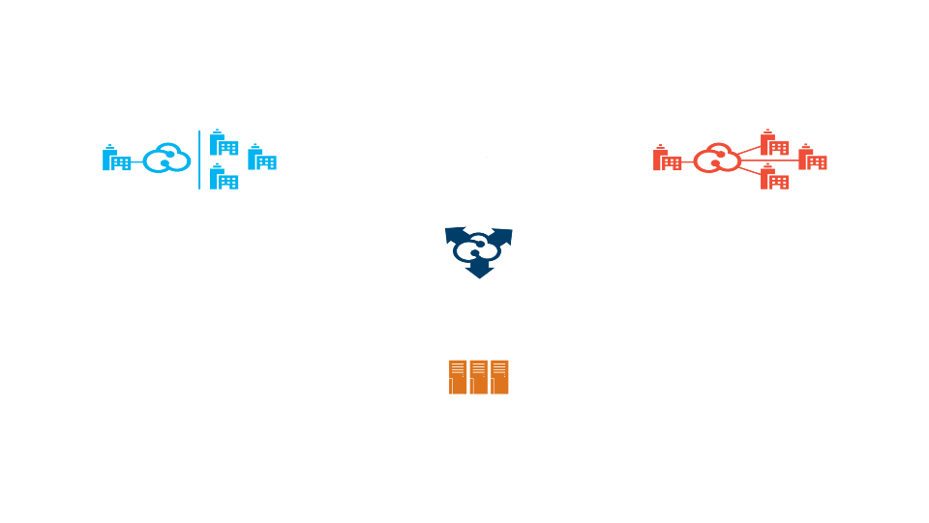
Cloud Deployment Models
Customers are choosing a variety of cloud models to meet their unique needs and priorities
Private cloud
Public cloud
On or off premises cloud infrastructure operated solely for an organization and managed by the organization or a third party
Hybrid Cloud
Available to the general public or a large industry group and owned by an organization selling cloud services.
Traditional IT and clouds (public and/or private) that remain separate but are bound together by technology that enables data and application portability
Community Clouds
Provisioned for exclusive use by specific consumers with shared concerns (e.g. security requirements, policy, and compliance considerations).
It may be owned, managed, and operated by one or more of the organizations in the community.
Traditional IT
Appliances, pre-integrated systems and standard hardware, software, and networking.

Slide 27



Create a roadmap for cloud as part of the existing IT optimization strategy
Standardize and automate
Standardize services
Reduce deployment cycles
Enable scalability
Flexible delivery
Virtualize
Remove physical resource boundaries
Increase hardware utilization
Reduce hardware costs
Simplify deployments
Consolidate
Reduce infrastructure complexity
Reduce staffing requirements
Manage fewer things better
Lower operational costs

